Slide 1
Combinational circuits design
Unit - IV
J.SHEIK SHABJAN M.Sc., M.Phil., SET
ASSISTANT PROFESSOR
DEPARTMENT OF ELECTRONICS
St. JOSEPH’S COLLEGE (Autonomous),
TRICHY

Slide 2
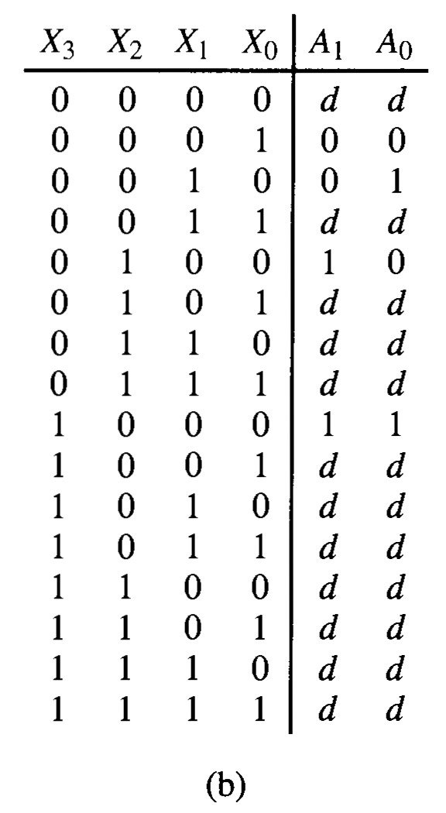
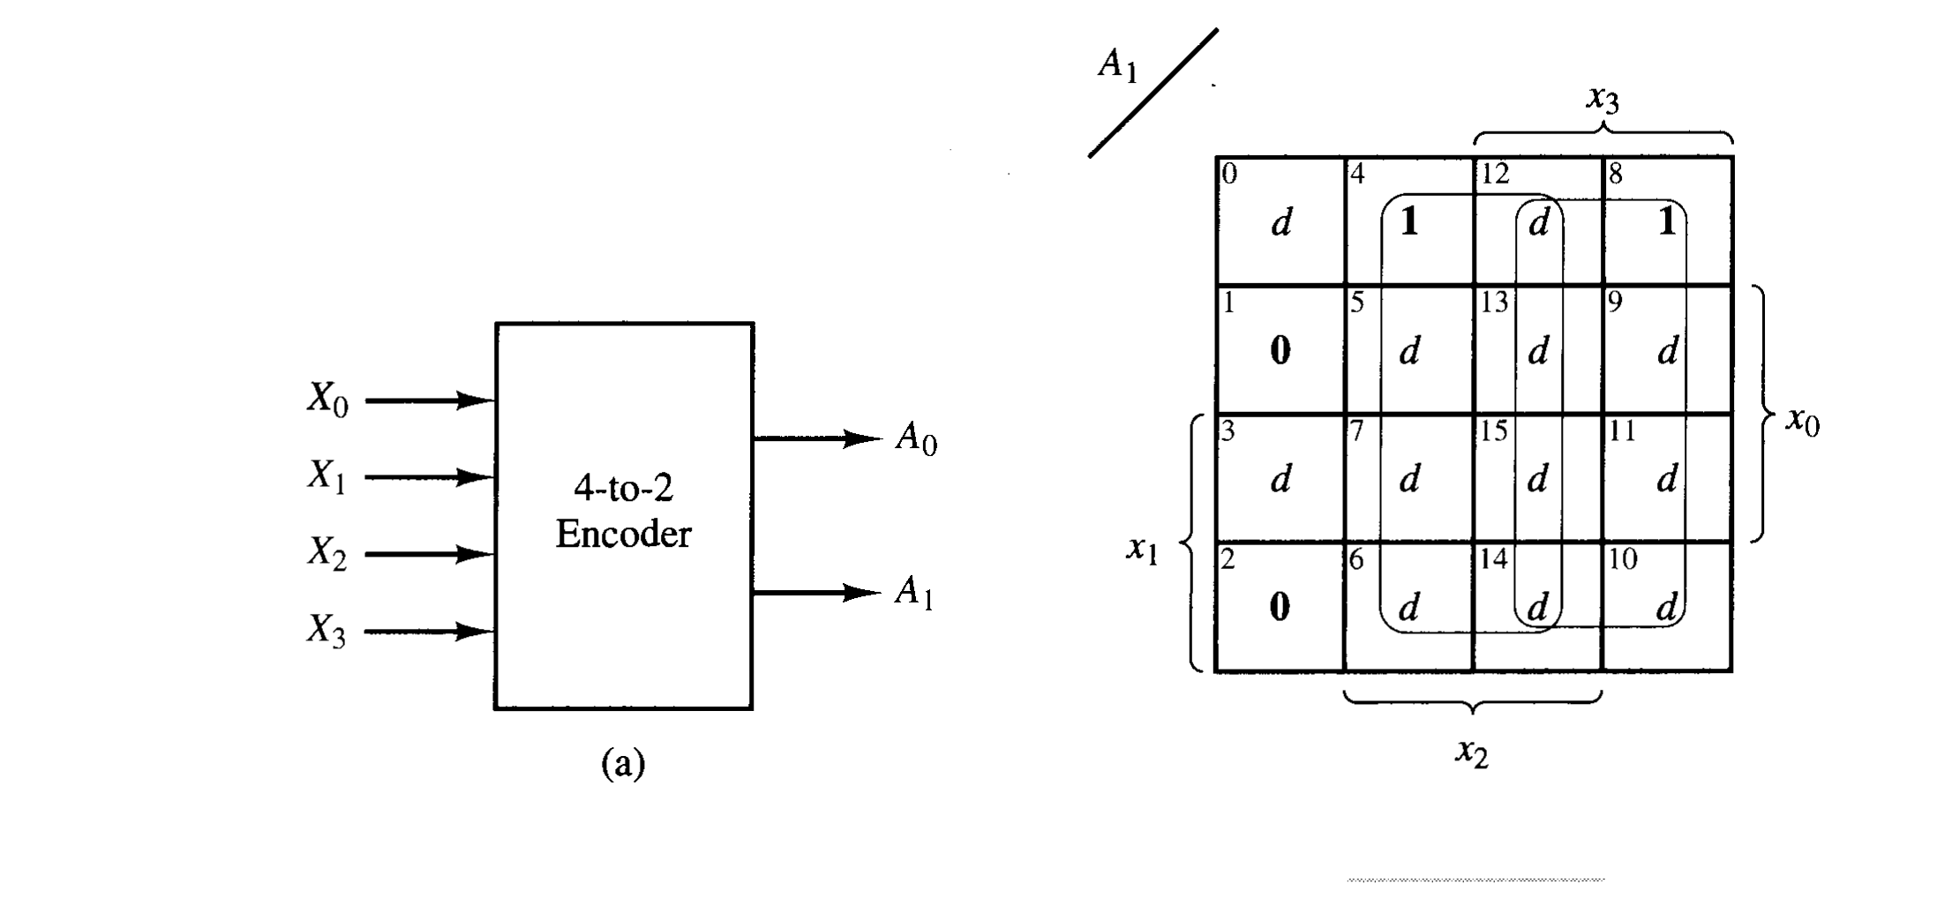

4 to 2 line encoder
Truth table
Functional diagram

Slide 3
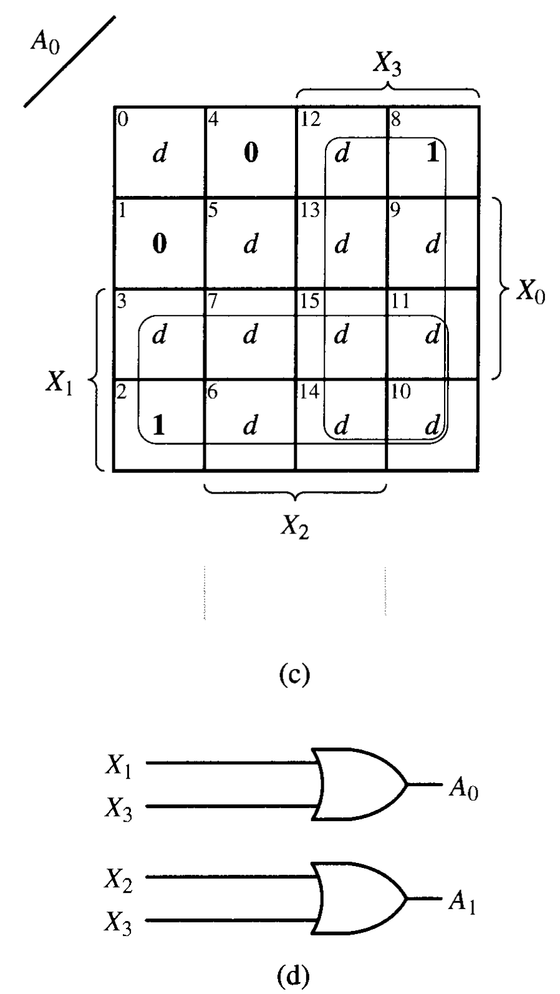


4 to 2 line encoder
K - maps

Slide 4
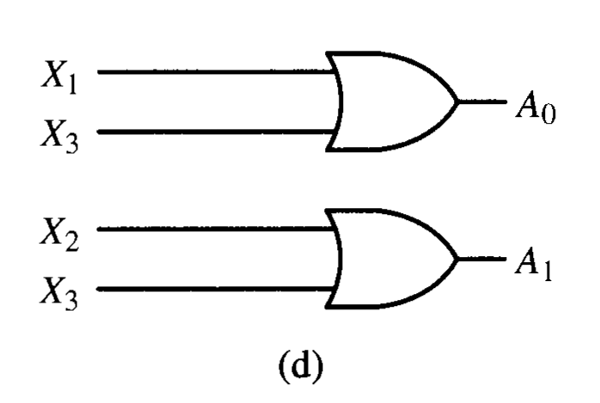
4 to 2 line encoder
Logic diagram

Slide 5
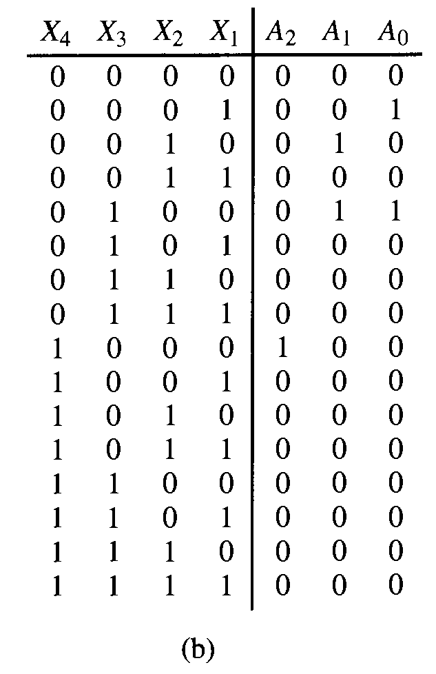
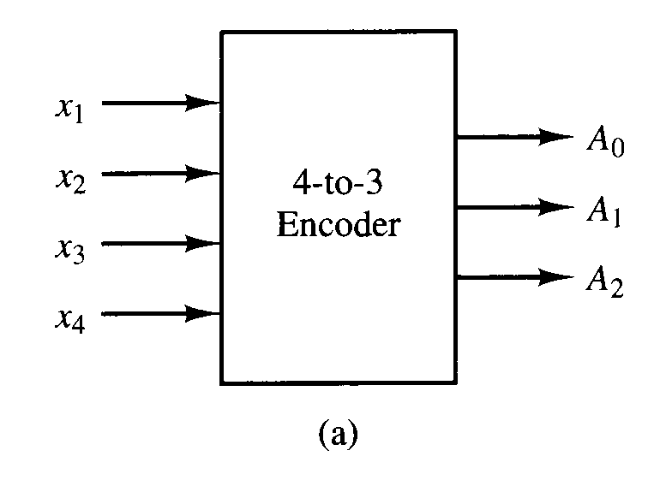
4 to 3 line encoder
Truth table
Functional diagram

Slide 6
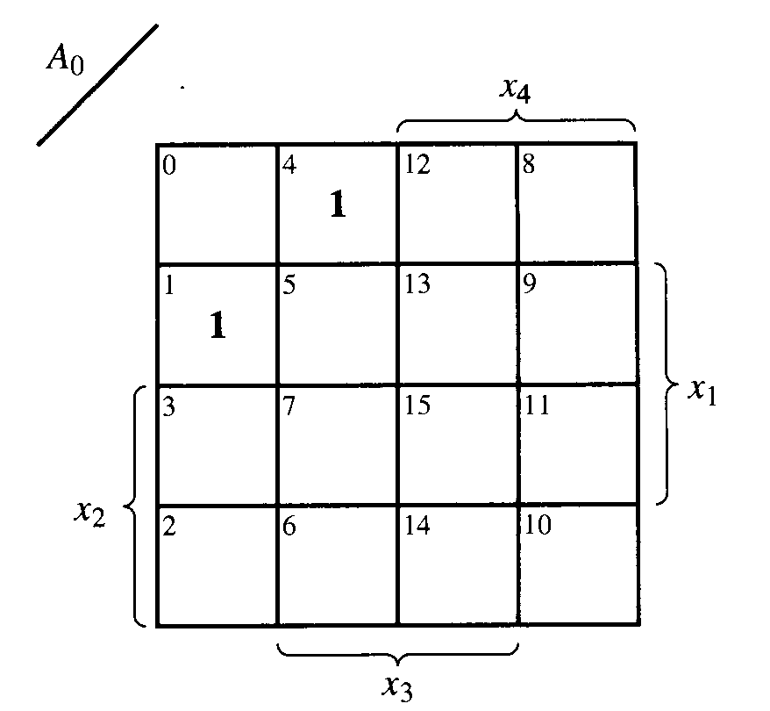
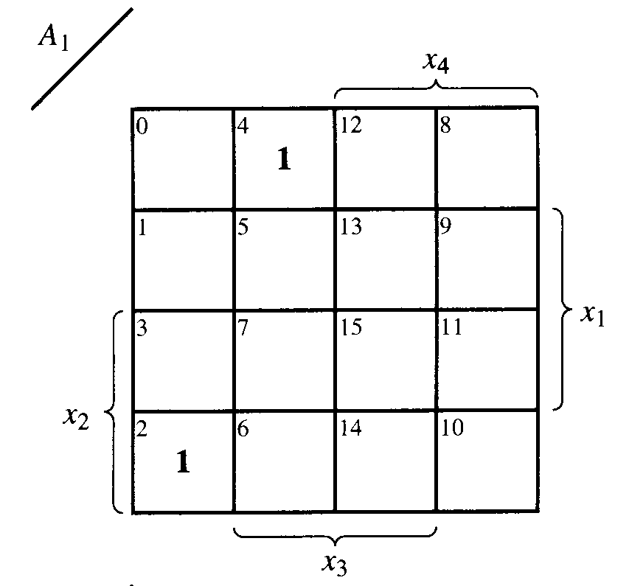
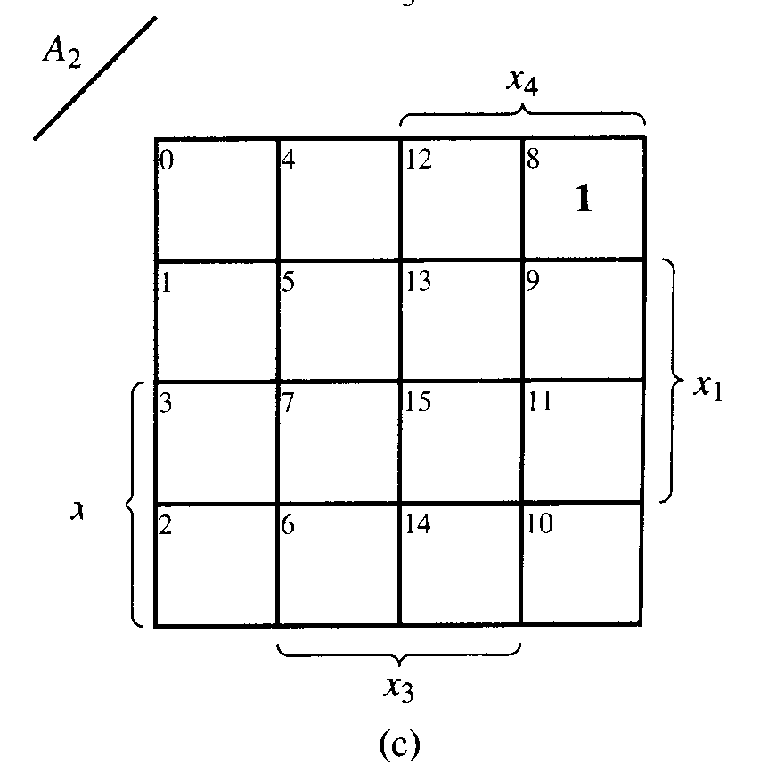
4 to 3 line encoder
K - maps

Slide 7
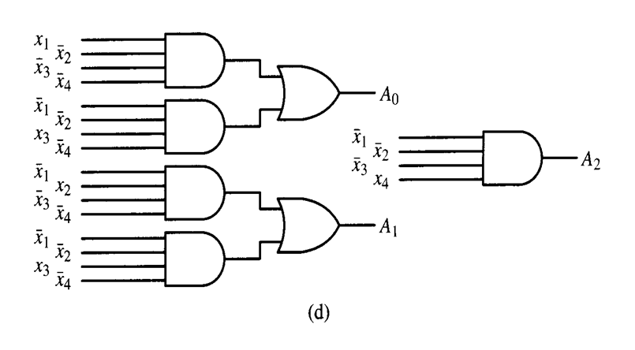
4 to 3 line encoder
Logic diagram

Slide 8
priority encoder
The priority encoder allows multiple input lines to be active and sends out the binary value of the subscript of the input line with highest priority.
If no input line is active, the priority encoder sends out (A₁A₀) = (00).
If a single line is active, the encoder sends out the binary values of the subscript of the active line.
If more than one input is active, the encoder sends out the binary value of the largest subscript of the active lines.
Two additional output lines (EO ) and (GS ).

Slide 9
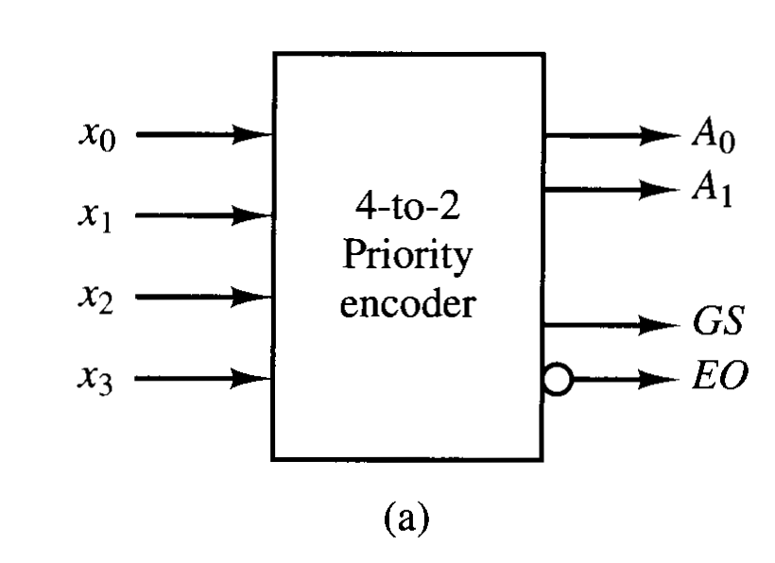
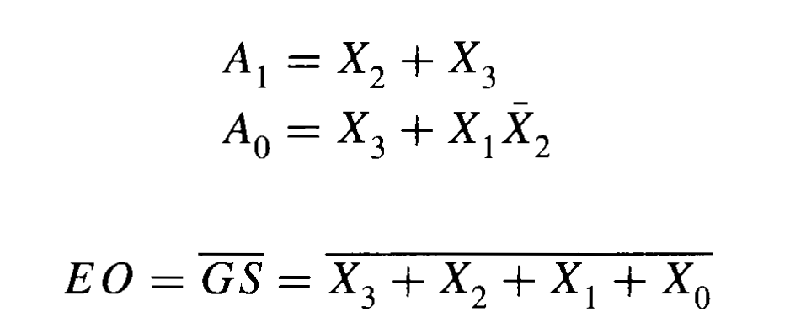
4 to 2 priority encoder
Functional diagram

Slide 10
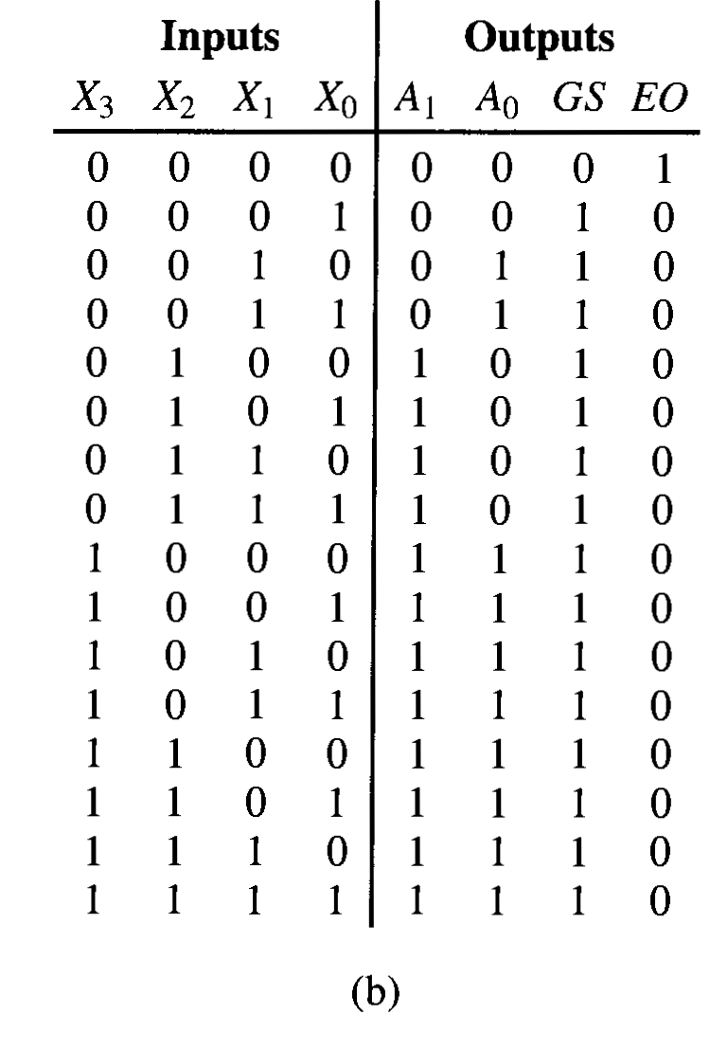
4 to 2 priority encoder
Truth table

Slide 11
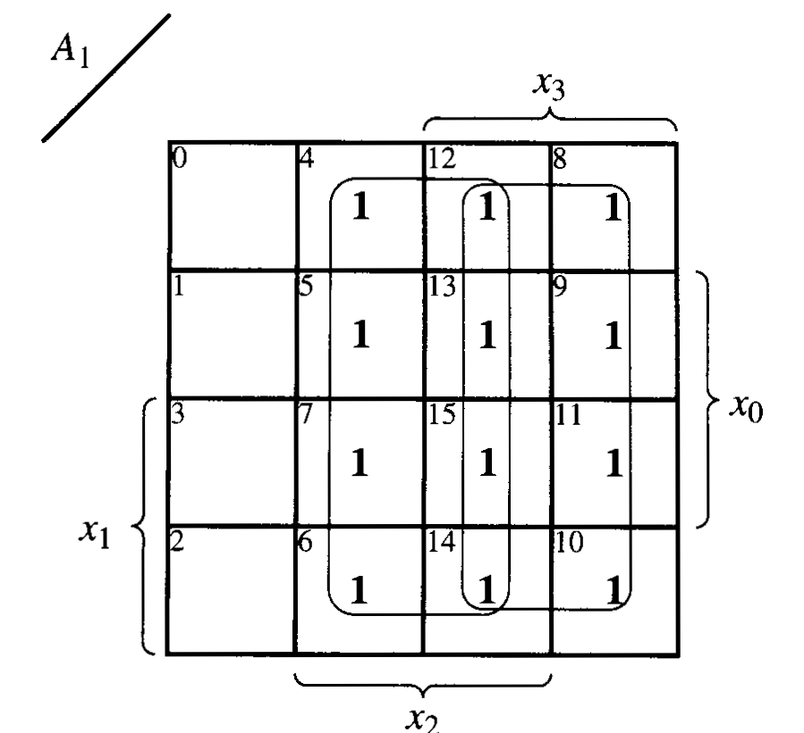
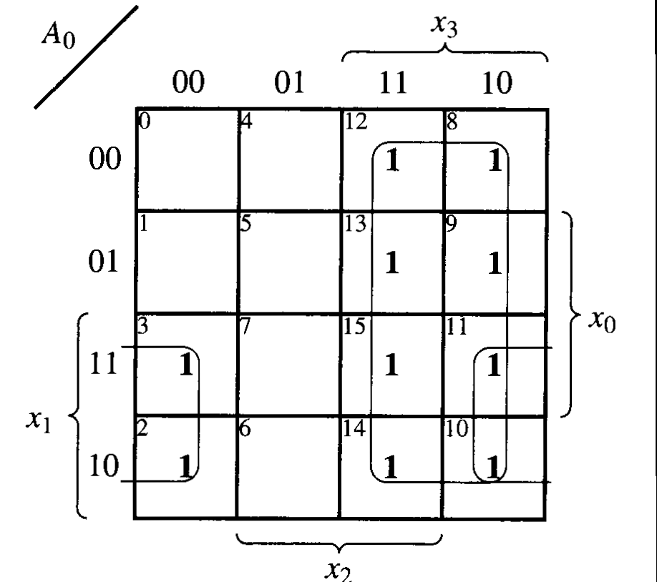
4 to 2 priority encoder
K - maps

Slide 12
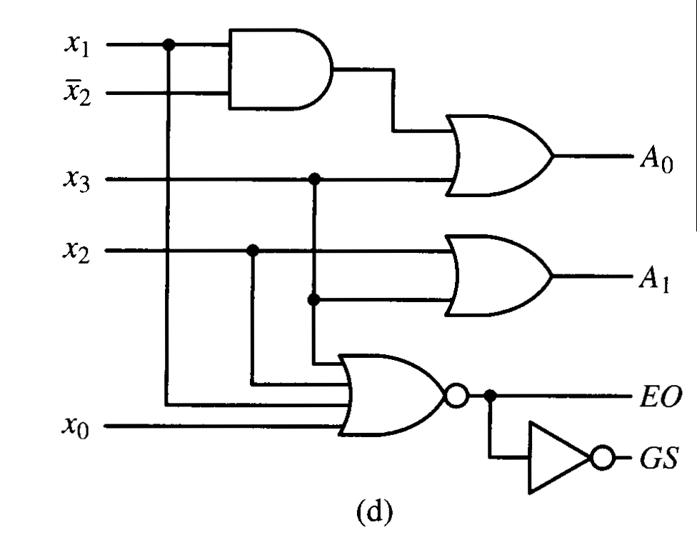
4 to 2 priority encoder
Logic diagram

Slide 13
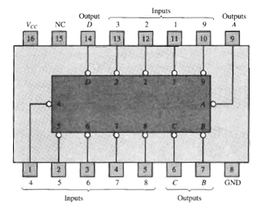
74147 priority encoder

Slide 14
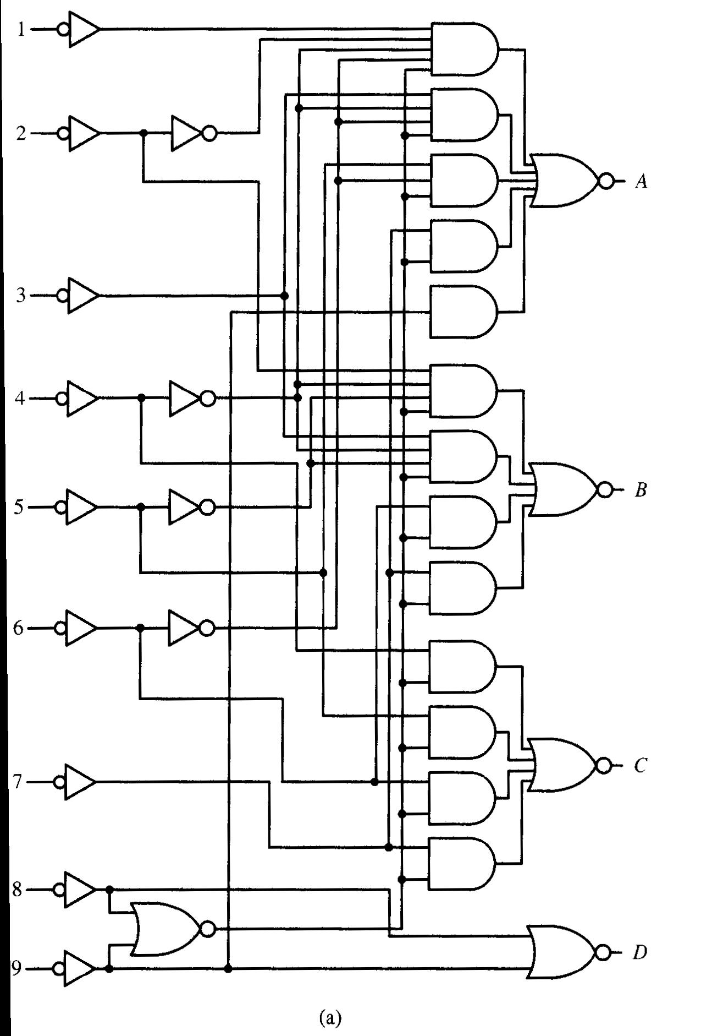
Logic diagram

Slide 15
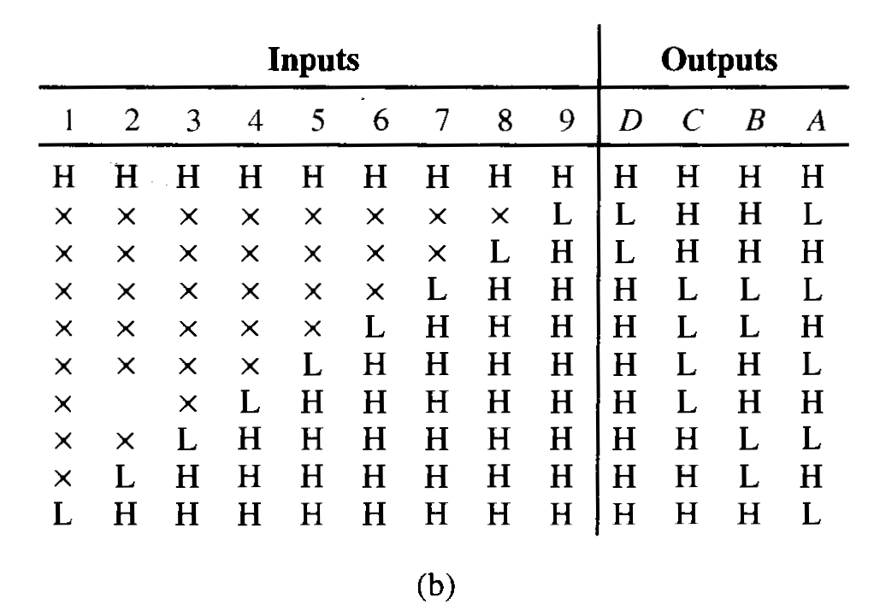
Functional table

Slide 16
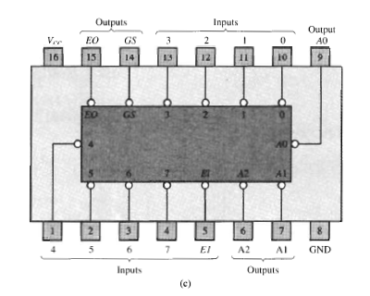
74148 priority encoder

Slide 17
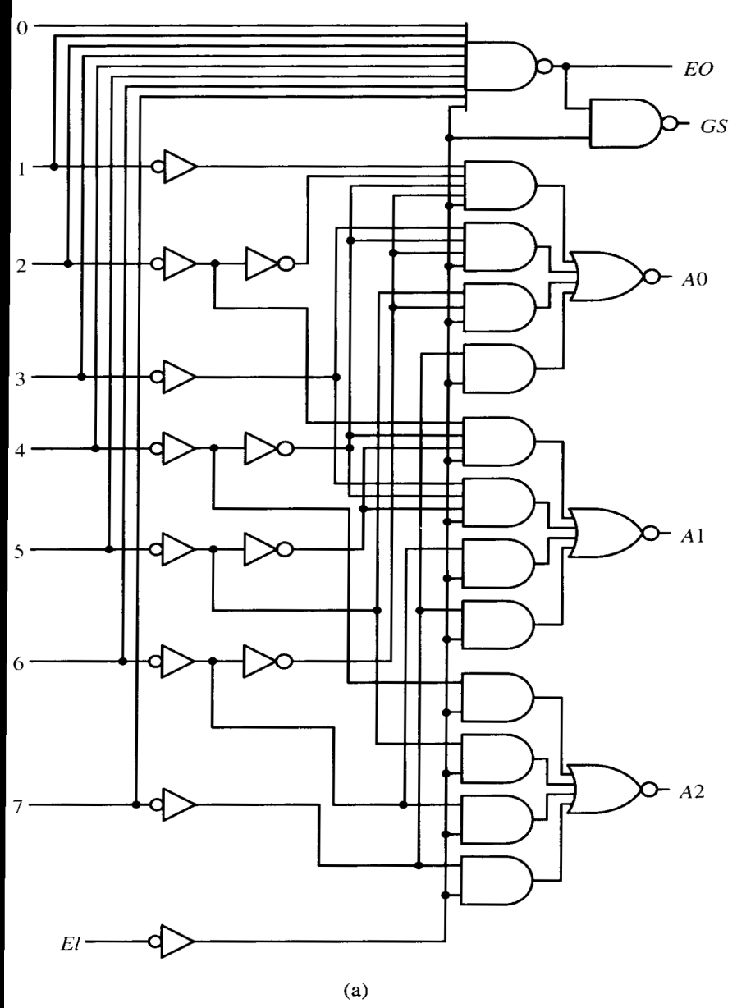
Logic diagram

Slide 18
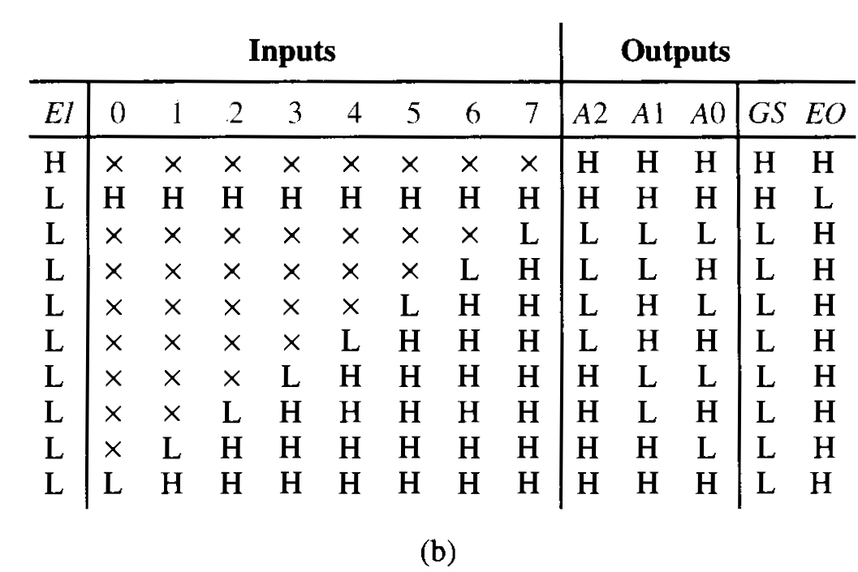
Functional table

Slide 19
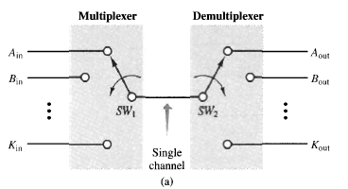
Multiplexers/data selectors

Slide 20
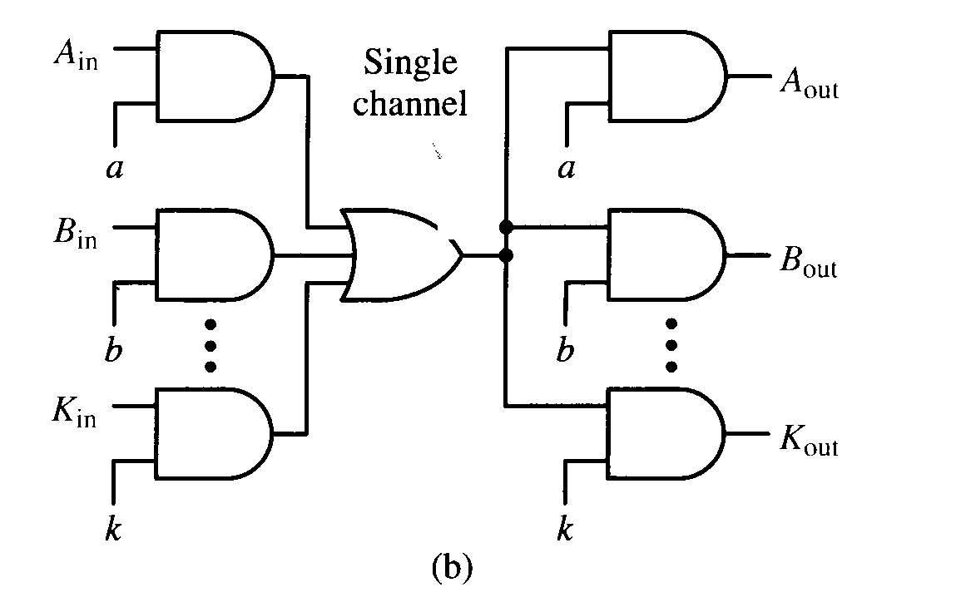
K channel multiplexing/demultiplexing

Slide 21
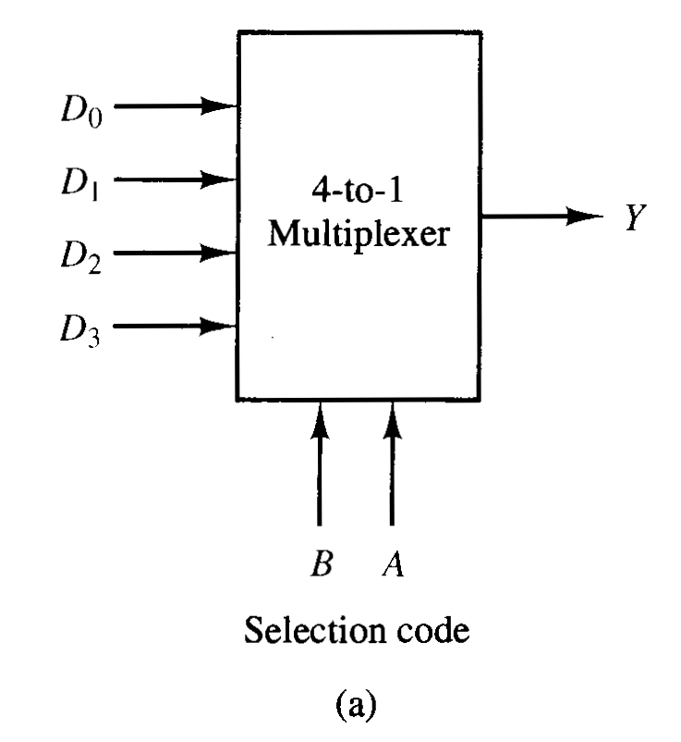
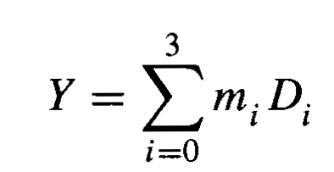
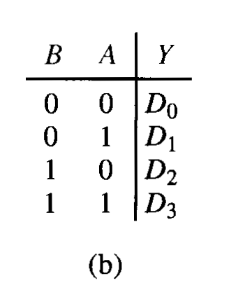
4 to 1 line multiplexer

Slide 22
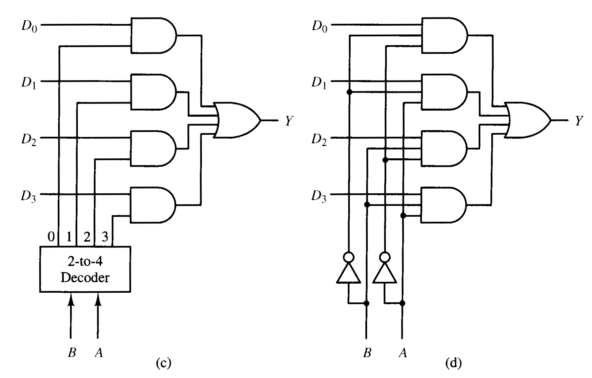
Equivalent two level circuit

Slide 23
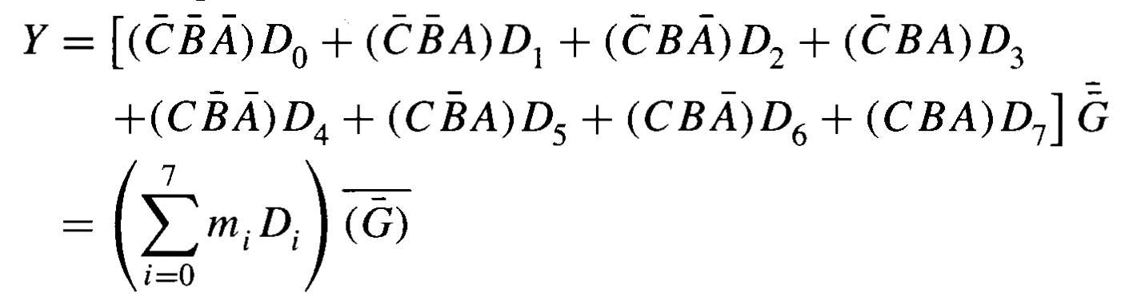
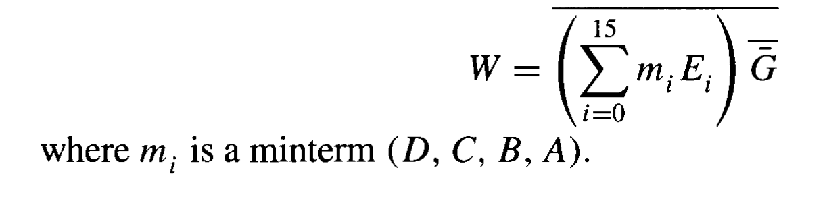
Standard msi multiplexers
74151A (8 to 1 multiplexers)
74150 (16 to 1 multiplexers)

Slide 24
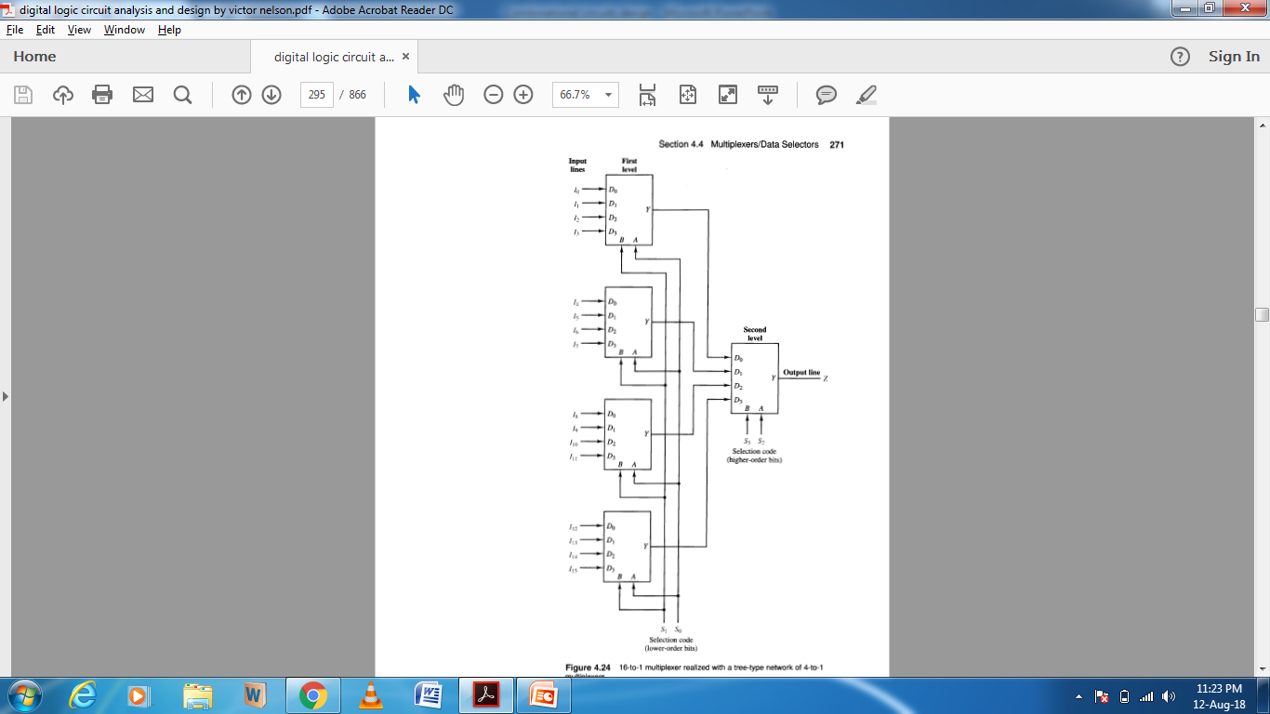
16 to 1 multiplexer realized with a tree type network of 4 to 1 multiplexers

Slide 25
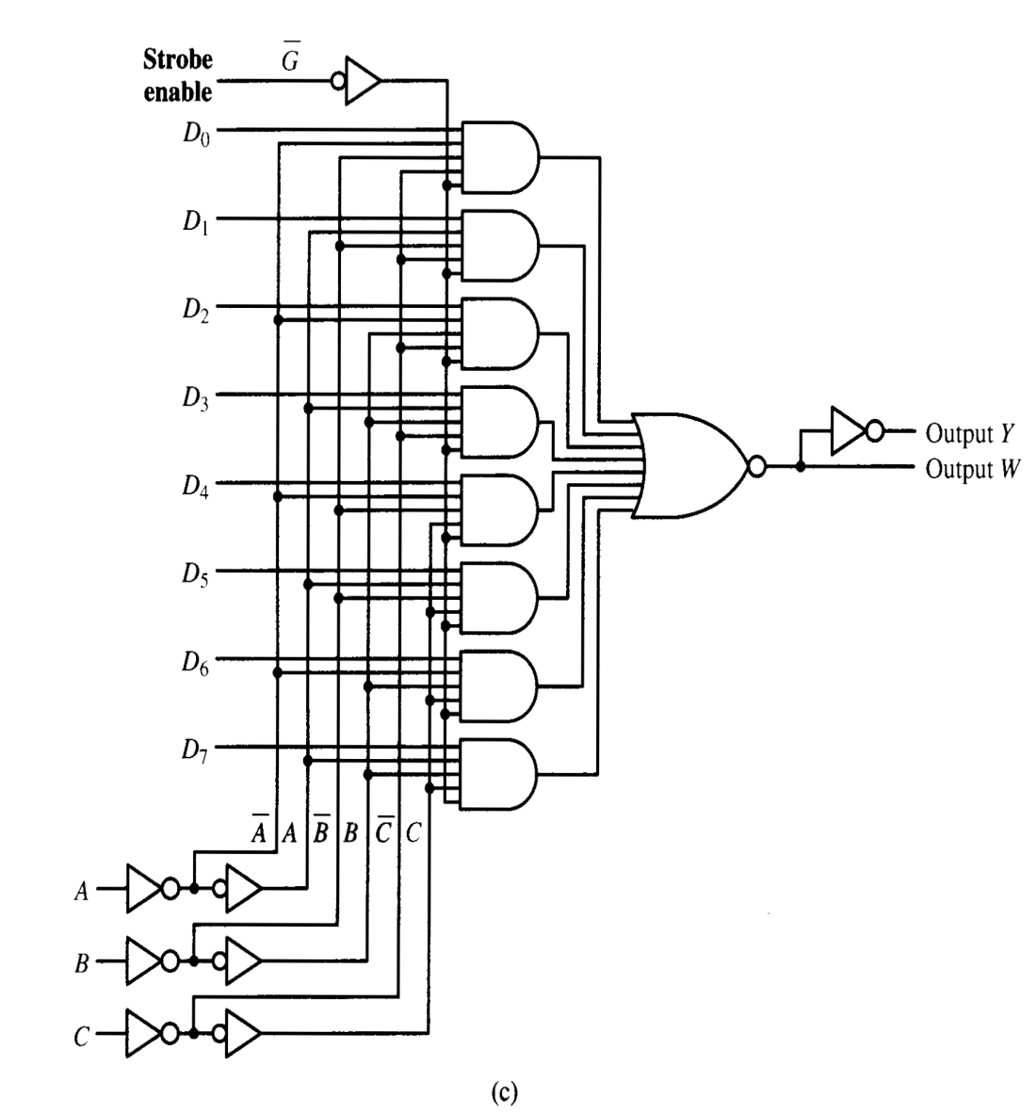
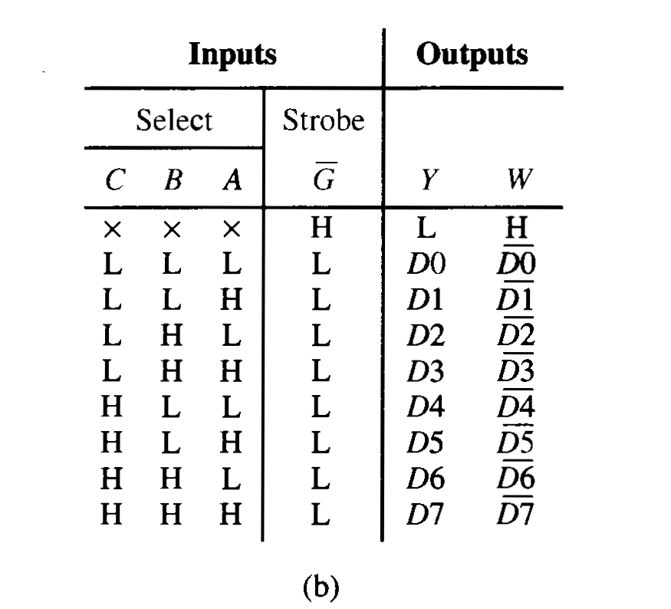
74151A (8 to 1 multiplexers)

Slide 26
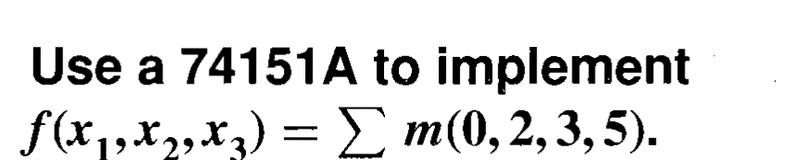
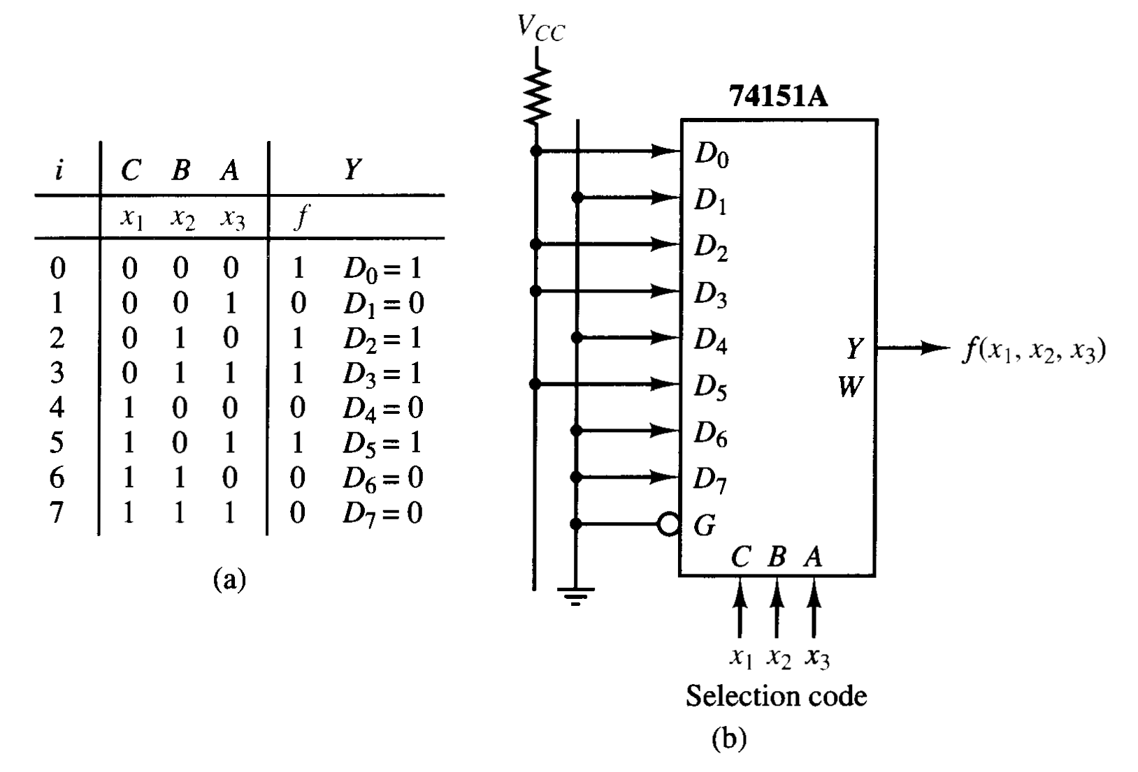
Example

Slide 27
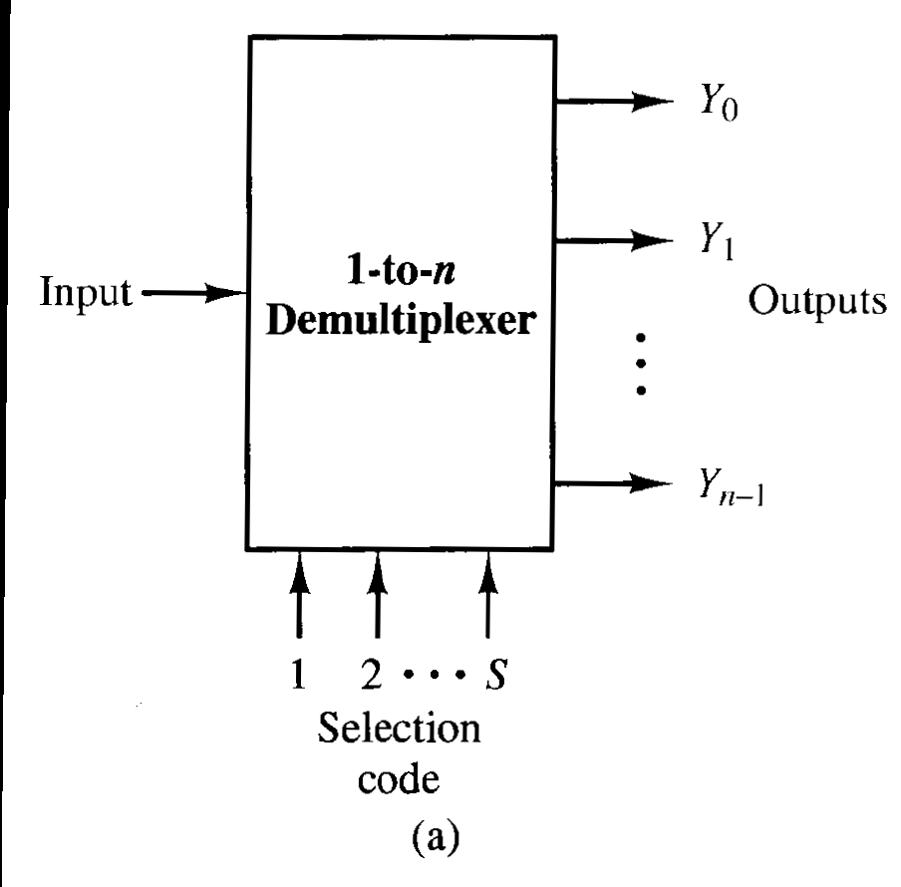
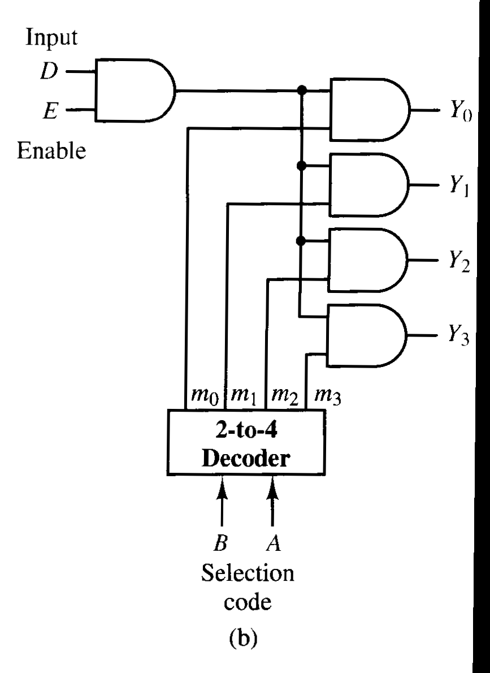
Demultiplexer / data distributors

Slide 28
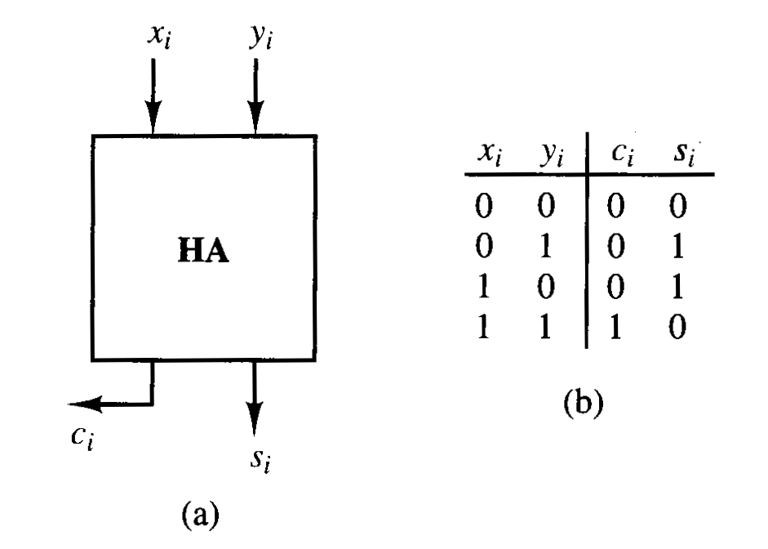
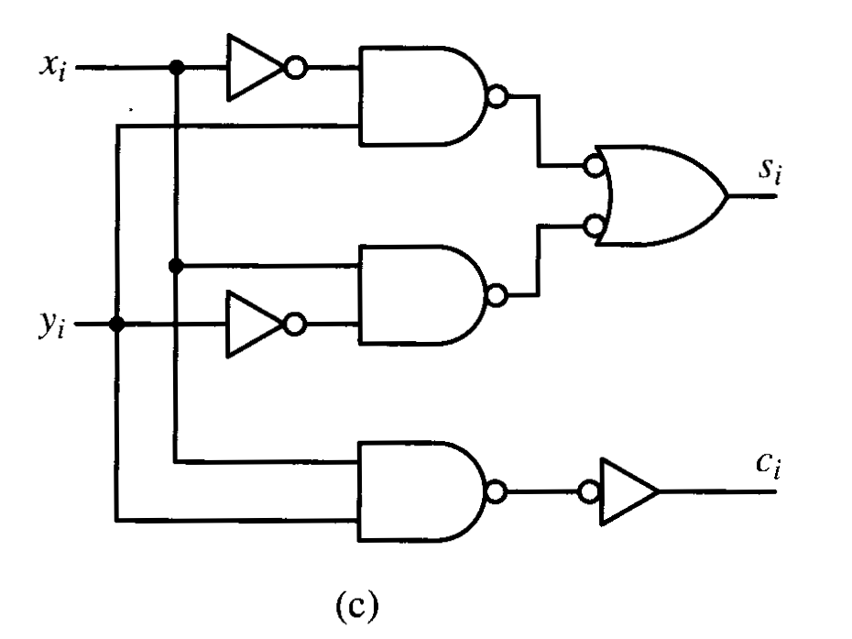
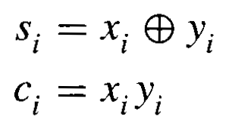
Basic Binary adder circuits
Half adder

Slide 29
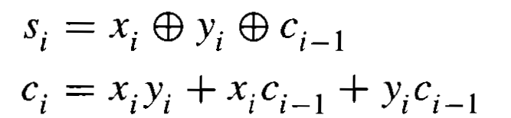
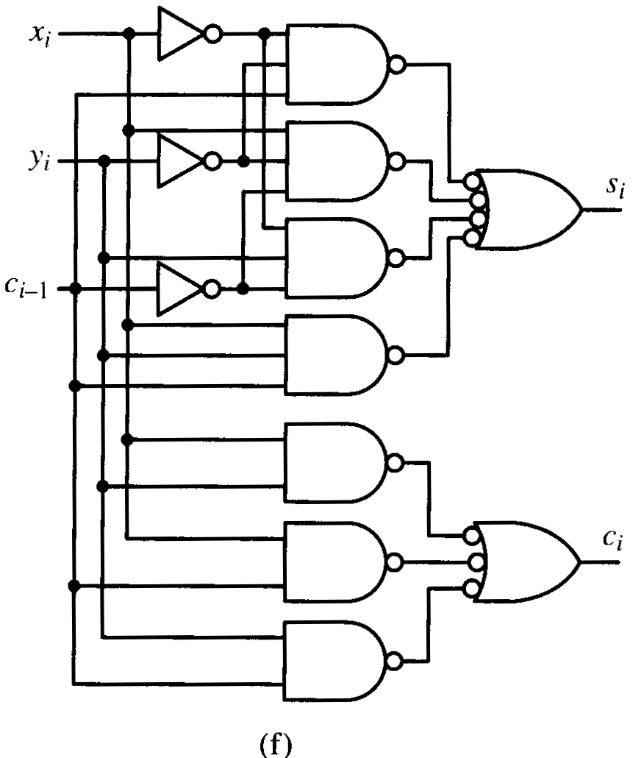
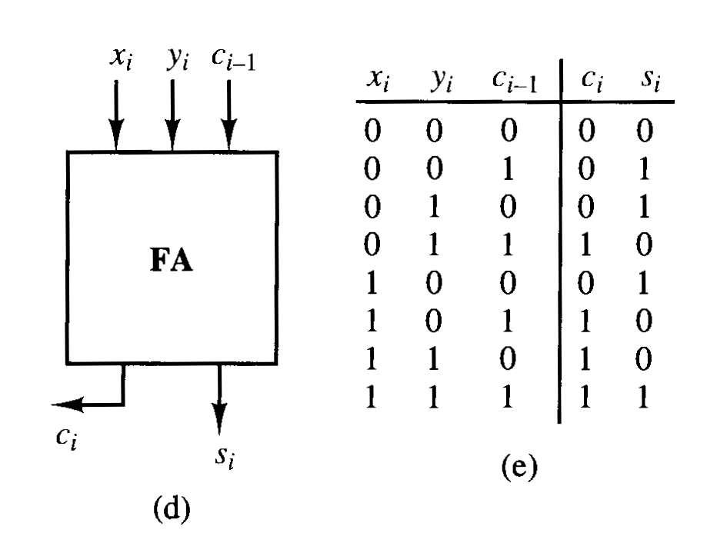
Full Adder

Slide 30
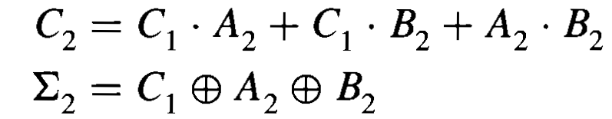

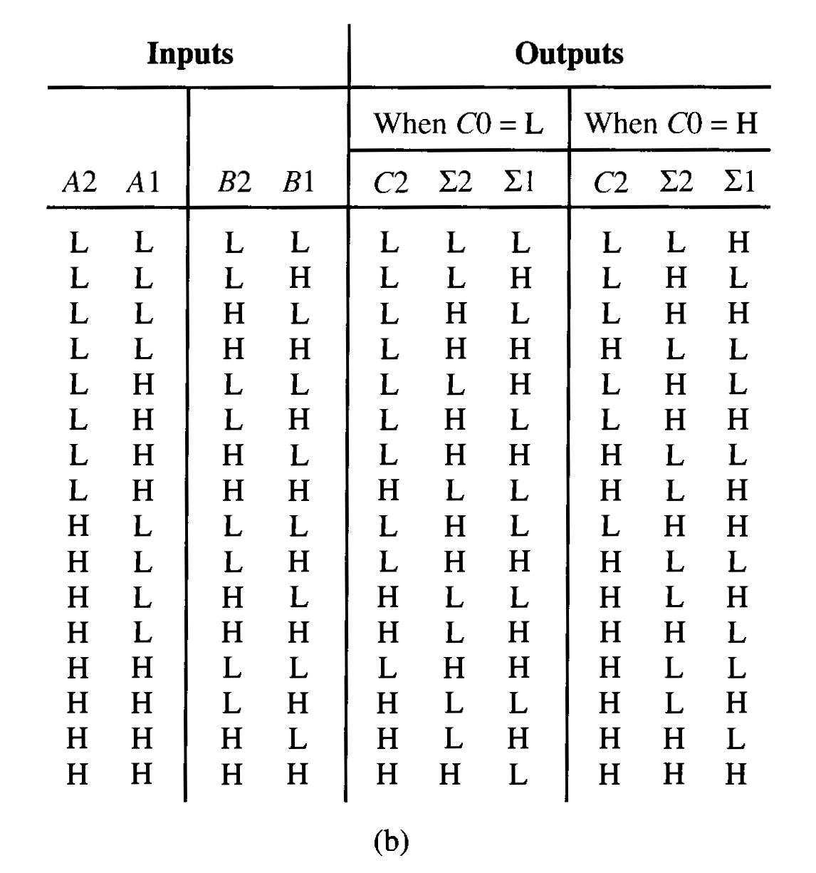
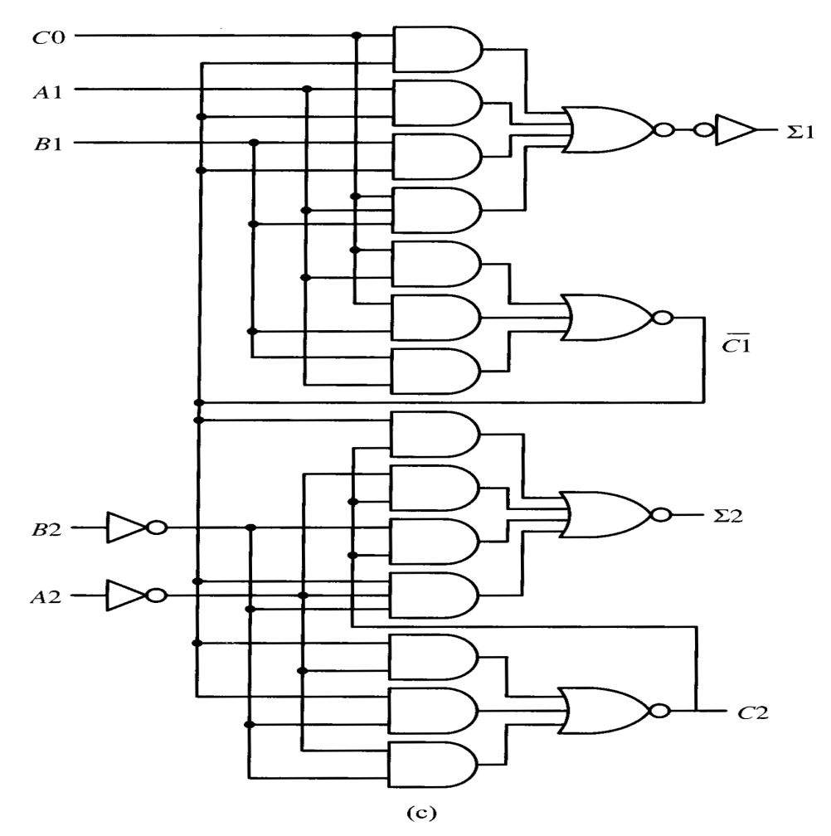
Pseudoparallel adder module

Slide 31
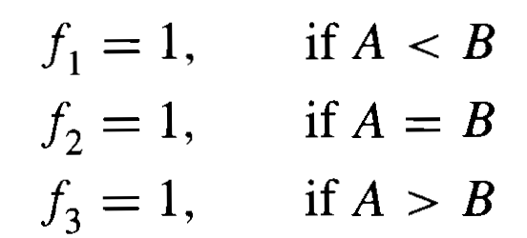
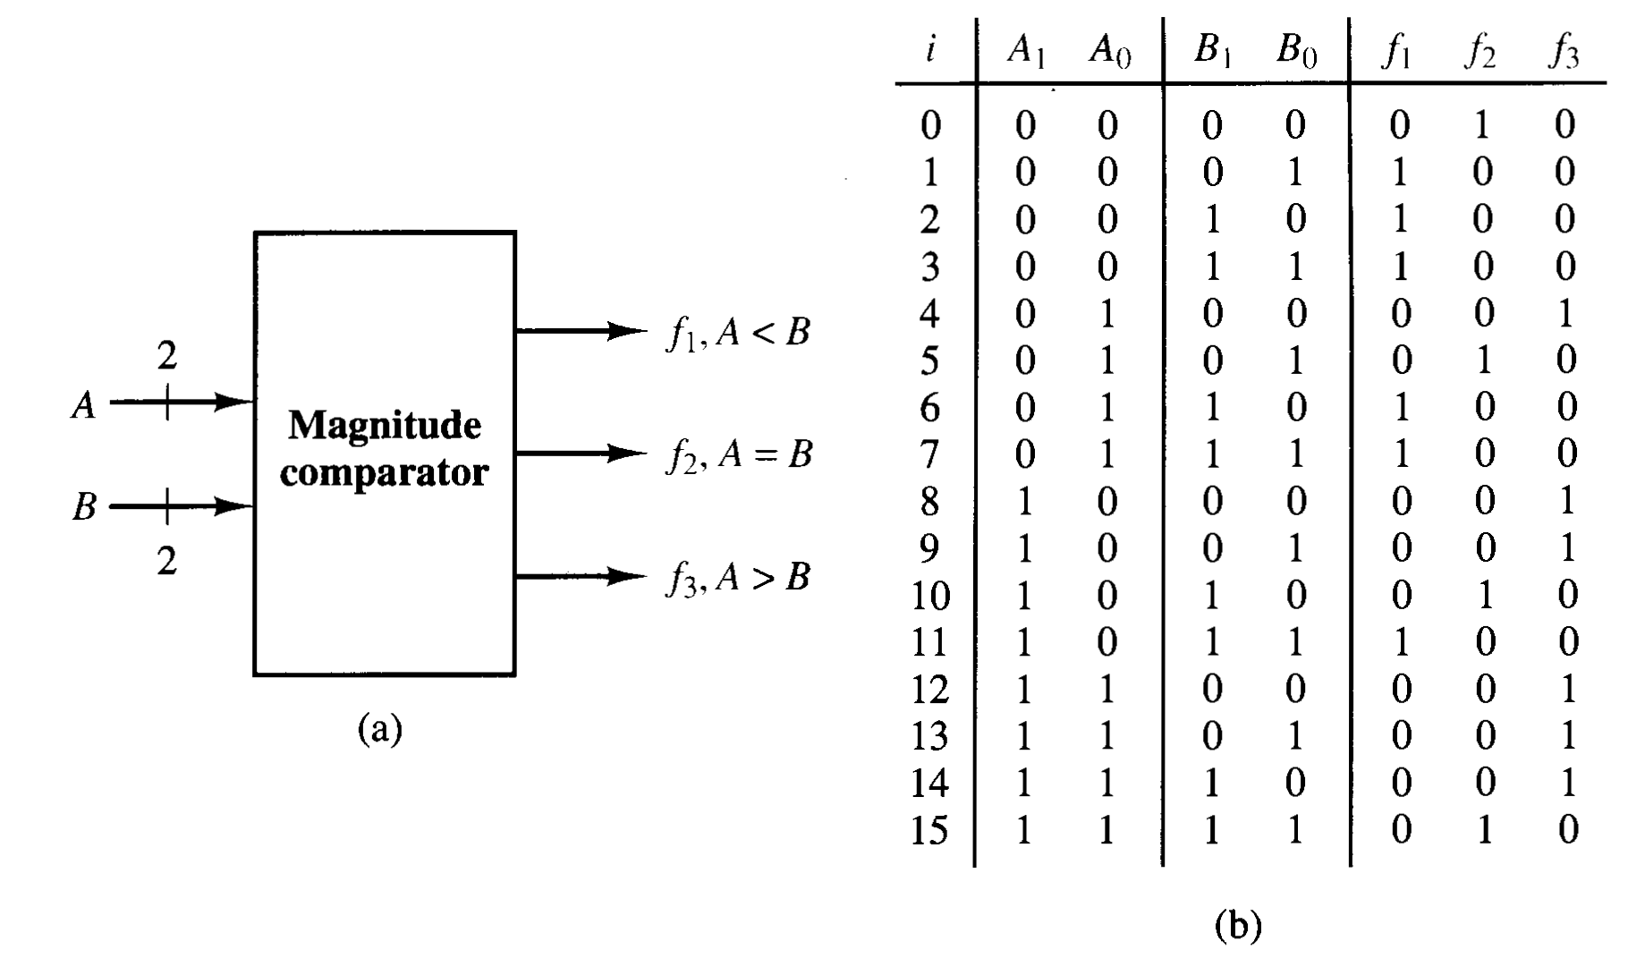

Comparator

